Slide 1
UNIT 4
Cloud Computing Technologies and Applications

Slide 2
Table of Content
Cloud Computing Technologies and Applications :
Content Delivery Network (CDN) Services,
Multi-CDN, Features of Meta CDN,
Mobile Cloud Computing (MCC),
InterCloud Issues

Slide 3
Content Delivery Network (CDN) Services in CLoud
A content delivery network (CDN) is a geographically dispersed network of servers and data centers.
The primary goal of a CDN is to improve web performance by reducing the time needed to send content and rich media to users.
CDN architecture is also designed to reduce network latency caused by hauling traffic over long distances and across several networks.
CDN servers are often referred to as "edge servers" since all CDN servers are located on the "edge network" — closer to end-users than a host server from which an application or a website originates.

Slide 5
COMPONENTS OF CDN
a
EDGE SERVERS
LOAD BALANCING
CACHING
SECURITY

Slide 6
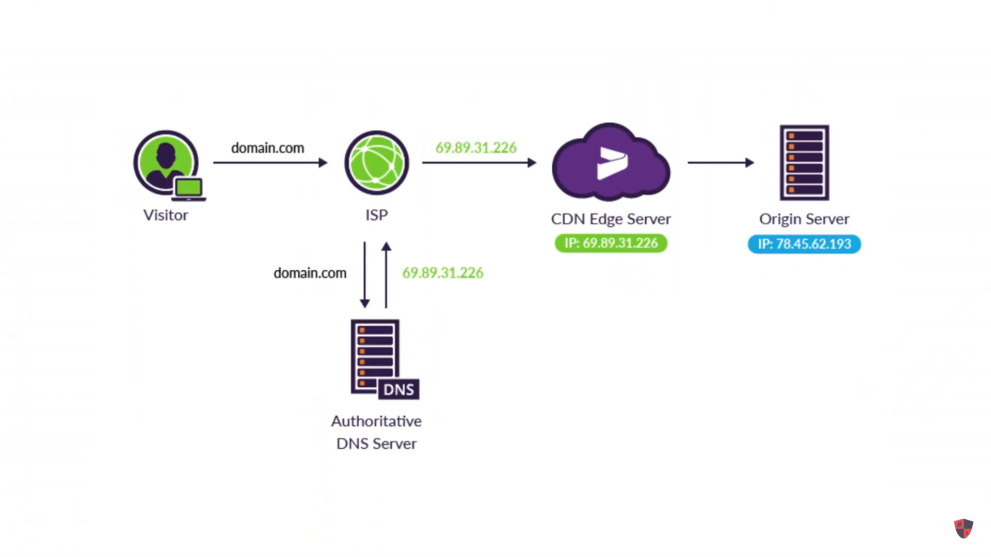

Slide 7
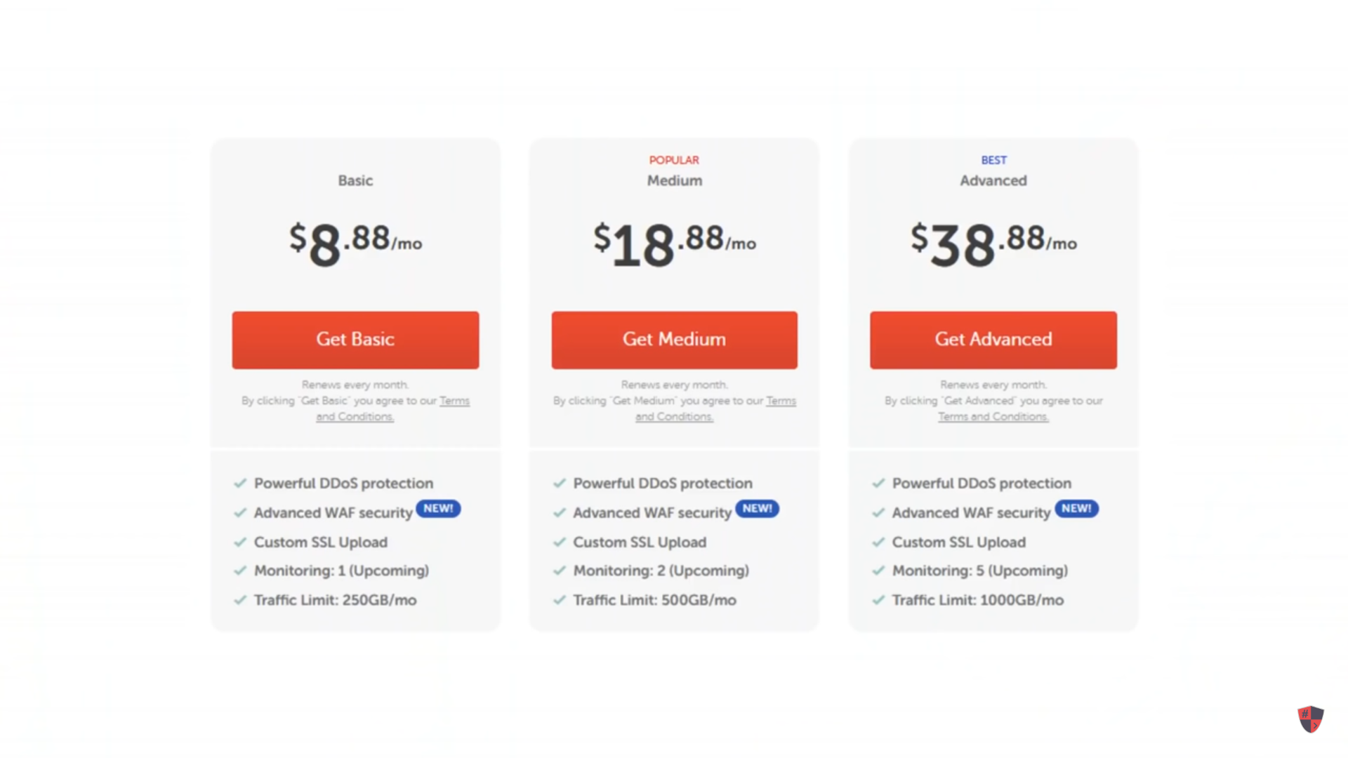

Slide 10
TYPES OF CDN
p
CDN
PUSH CDN
HYBRID CDN
PULL CDN
PEER-TO-PEER CDN(P2P)

Slide 11
Benefits of CDN
Efficiency. CDNs improve webpage loading times and reduce bounce rates. Both advantages keep users from abandoning a slow-loading site or e-commerce application.
Security. CDNs enhance security with services such as DDoS mitigation, WAFs and bot mitigation.
Availability. CDNs can handle more traffic and avoid network failures better than the origin server, increasing content availability.
Optimization. These networks provide a diverse mix of performance and web content optimization services that complement cached site content.
Resource and cost savings. CDNs reduce bandwidth consumption and costs.

Slide 12
Multi-CDN
A multi-CDN is the combination of multiple CDNs (content delivery networks) from different providers into a single network.
A multi-CDN strategy can help you reduce latency, improve performance and save costs

Slide 13
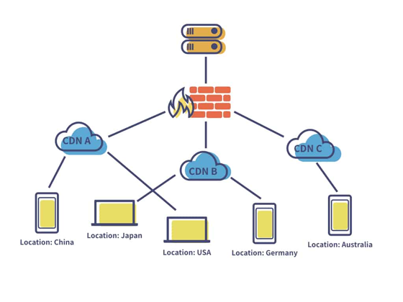
The implementation of
multi-CDN architecture requires
you to identify different CDN providers
and configure each network with your
website. You even need to define various
switching mechanisms, such as:
DNS-based switching
HTTP redirect-based switching
Client-side midstream switching
Manifest rewrite on-the-fly

Slide 14
Different Ways of Implementing Multi-CDN
There are different ways of implementing multi-CDN such as round-robin, DNS switching, manifest-rewrites, HTTP redirects, and client-side switching. Let’s look at how these techniques work.
Before we study the implementation of multi-CDN switching, let’s first take a look at how the decisions to switch CDNs are taken. There are primarily two ways of deciding which CDN to use – static rules-based switching or dynamic rules-based switching.
Static Rules-based Switching vs. Dynamic Switching
Static Rules-based switching is a naïve form of CDN switching where a rules-engine is programmed with simple instructions like “if CDN-A fails, then divert traffic to CDN-B.” This does not accommodate a lot of intelligence and needs to be monitored tightly to ensure that situations not governed by the rules do not crash the system.
In Dynamic rules-based switching, the decision to switch CDNs is based on continuously collected from the players, CDNs themselves, and other business rules. As these factors change dynamically during the day, the decisions change adaptively.
While the above applies to how the decisions are made, let’s now look at the actual implementation of the switching mechanisms, starting with the simple DNS-based switching.

Slide 15
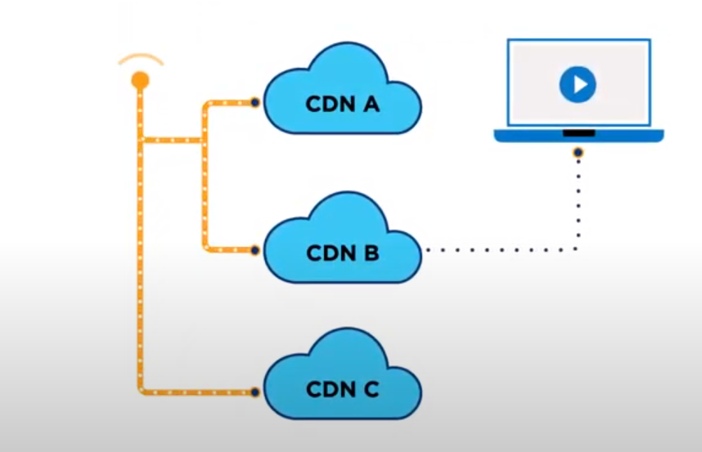

Slide 16
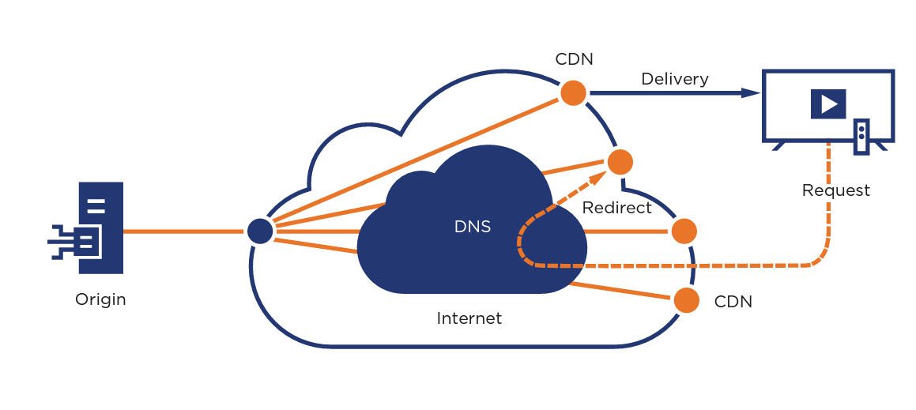

Slide 17
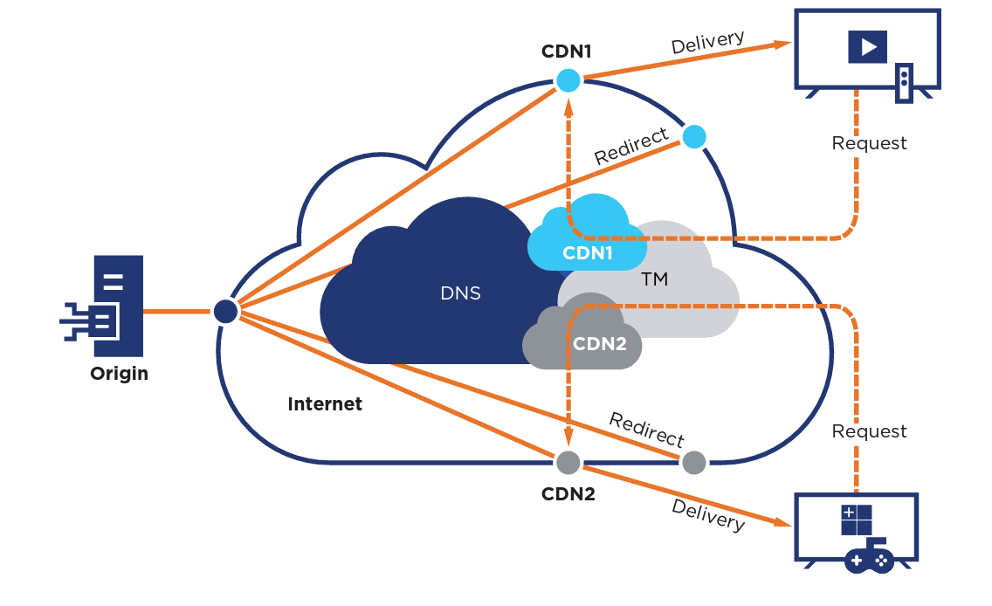

Slide 19
Meta CDN
MetaCDN is a cloud-based content delivery network company that also offers video transcoding, streaming video and web accelerator services.
Founded in 2011 from research out of the University of Melbourne, Meta
CDN is backed by Australian venture capital firm Starfish Ventures and the University of Melbourne's commercialization arm.
MetaCDN leverages services such as Amazon Web Services, Edgecast, and Windows Azure to offer users access to an integrated global network for content delivery. As of July 2012, the company reported having 102 access points in 5 continents on their website.

Slide 21
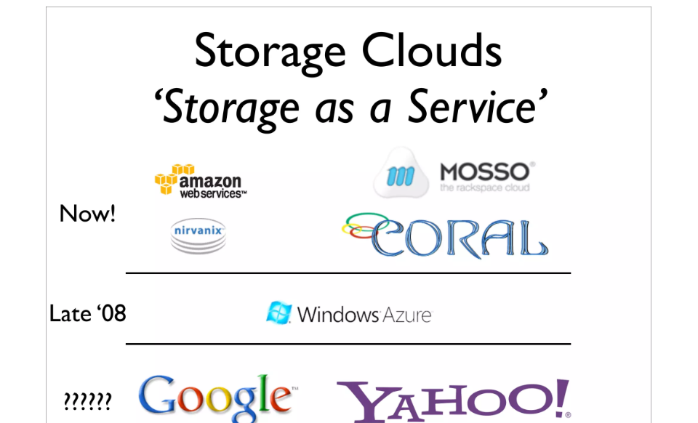

Slide 28
Mobile Cloud Computing (MCC)
Mobile cloud computing (MCC) is the method of using cloud technology to deliver mobile apps.
Complex mobile apps today perform tasks such as authentication, location-aware functions, and providing targeted content and communication for end users.
Examples of MCC
Finance and Commerce: Using your phone or tablet to track your account balance, making a purchase on ecommerce platforms such as Amazon, Shopify, etc., is an example of mobile cloud computing

Slide 29
Types of Cloud-Based Resources in MCC are:
Distant Immobile Cloud Computing
Hybrid Cloud Computing
Distant Mobile Clouds
Proximate Immobile Computing Entities
Proximate Mobile Computing Entities

Slide 30
p

Slide 32
p

Slide 34
InterCloud Issues
Intercloud or ‘cloud of clouds’ is a common term used for cloud computing.
An intercloud architecture moves data between the infrastructure of multiple cloud service providers (CSPs).
Intercloud systems enable organizations to take complete control of their application on the cloud and use corporate data anywhere, anytime. It offers seamless connectivity and addresses common organizational issues, like security, performance, and flexibility.
The concept of Intercloud was first introduced to the world in 2008 when Cisco- the global leader in IT and networking, started it as a research project.
Later, it was taken over by IEEE (Institute of Electrical and Electronics Engineers) to improve the functionality of existing cloud networks.
Later in early 2009, it gained popularity and was regarded as the data center of the future.

Slide 35
Intercloud is a cloud deployment model that links multiple public cloud services together as one holistic and actively orchestrated architecture.
For example, Amazon, Google, Microsoft, Salesforce.com, and others have established data centers for hosting cloud application services such as social networking, gaming portals, and business applications.

Slide 36
Issues
Lack of interoperability and adopted standards together with intricate regulatory context,
inflexible pricing models and
not adequate SLAs are recognised as the main obstacles to Cloud adoption.

